Slide 1
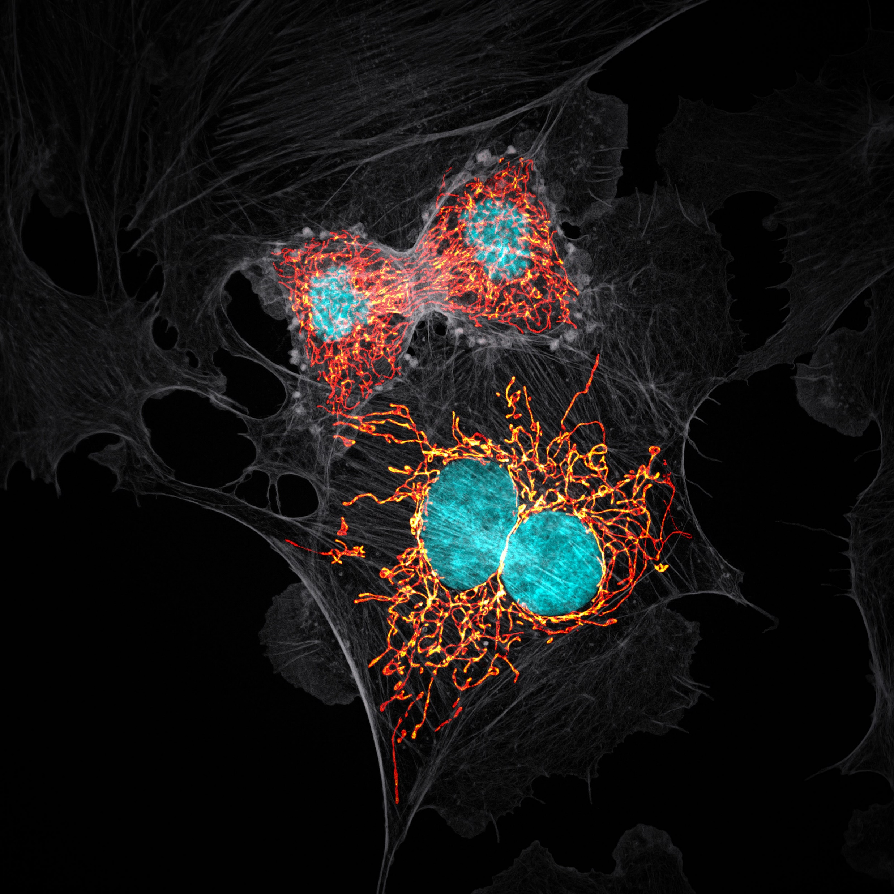


Seeing Is Not Believing
Image Credit: Jason Kirk - Baylor College of Medicine
Nikon Small World 2019 Prize Winner
Data
Analysis
In
Microscopy
The Case For Automating Image Analysis
Dave Barry • Francis Crick Institute

Slide 2
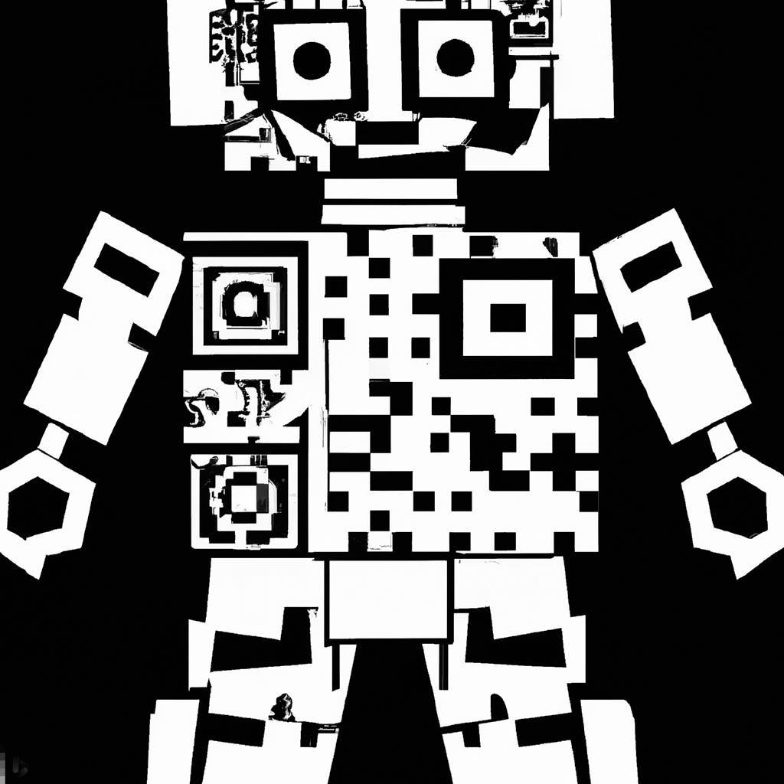
Have your phones ready to scan!

Slide 3
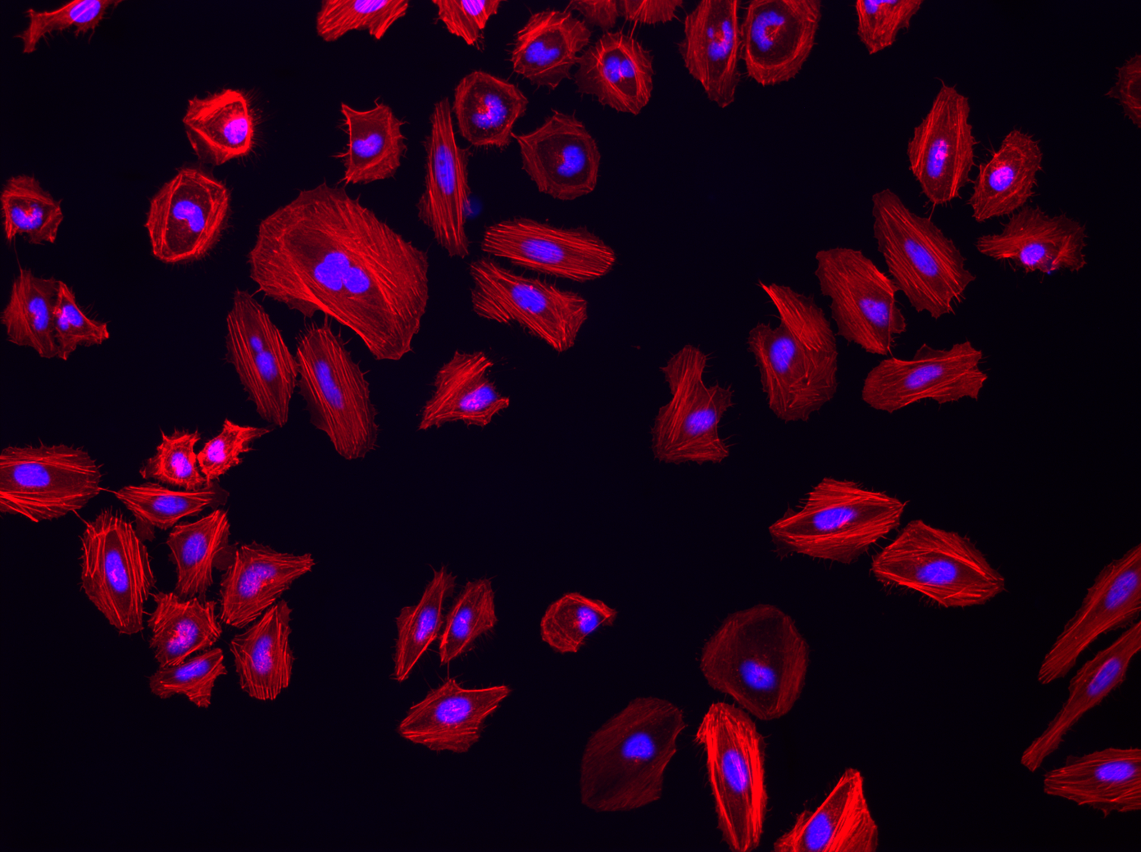





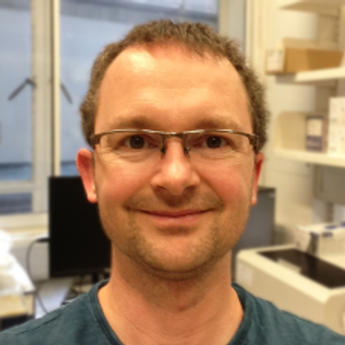


Coming up @ 13:00…
Introduction to automated object counting with…
Dale
Central 3 & 4
Stefania
Stay here!
Martin
Central 5, 6 & 7

Slide 4
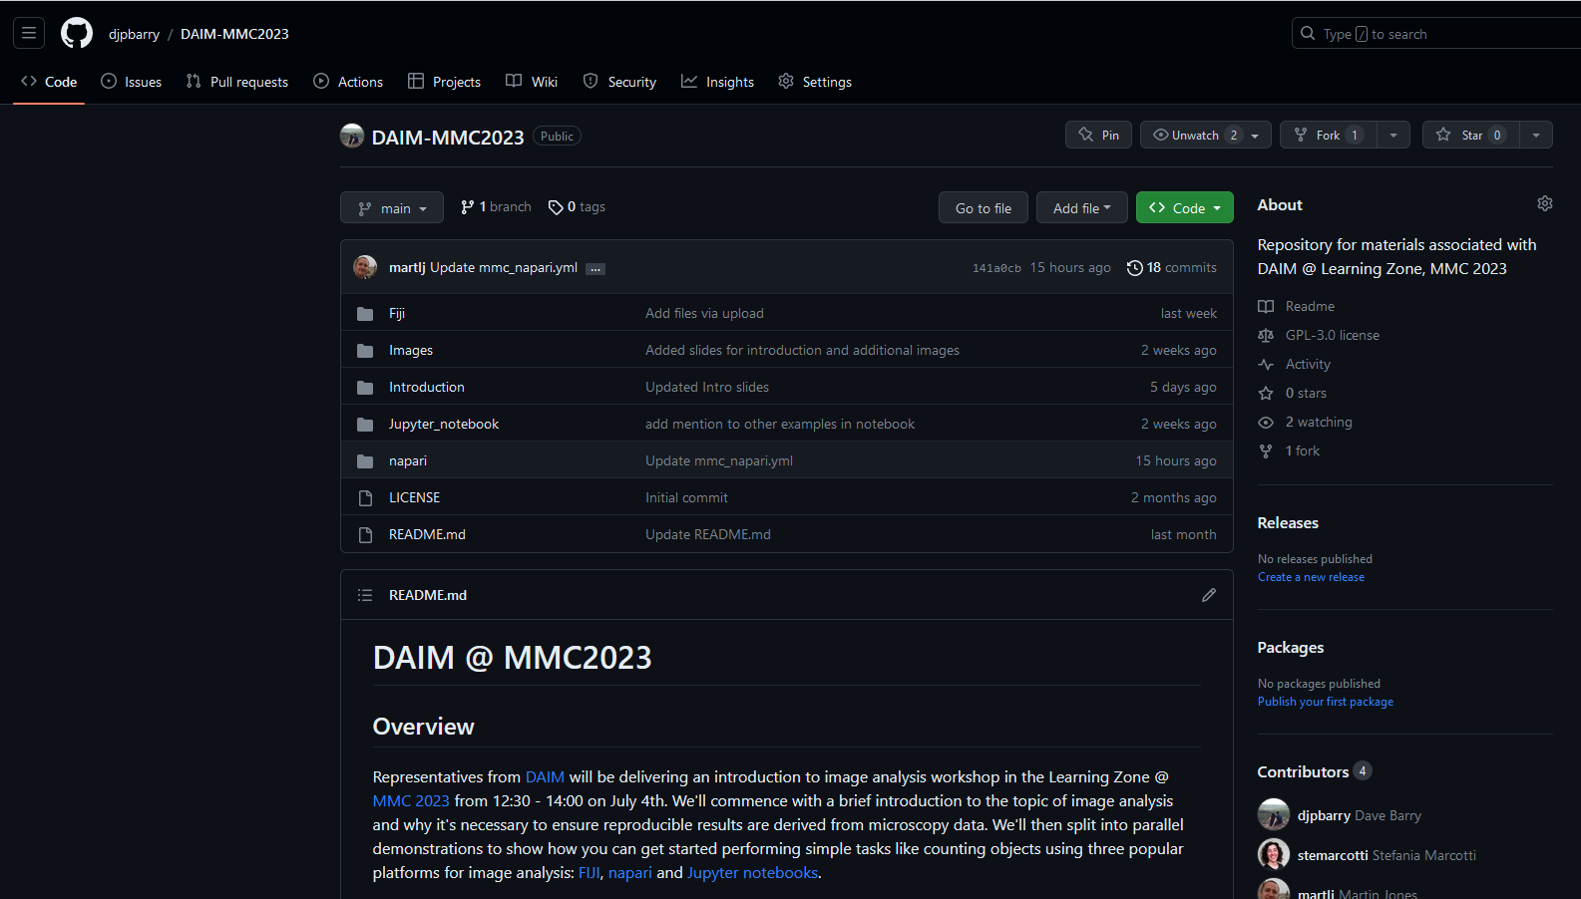


Slide 5


Slide 6
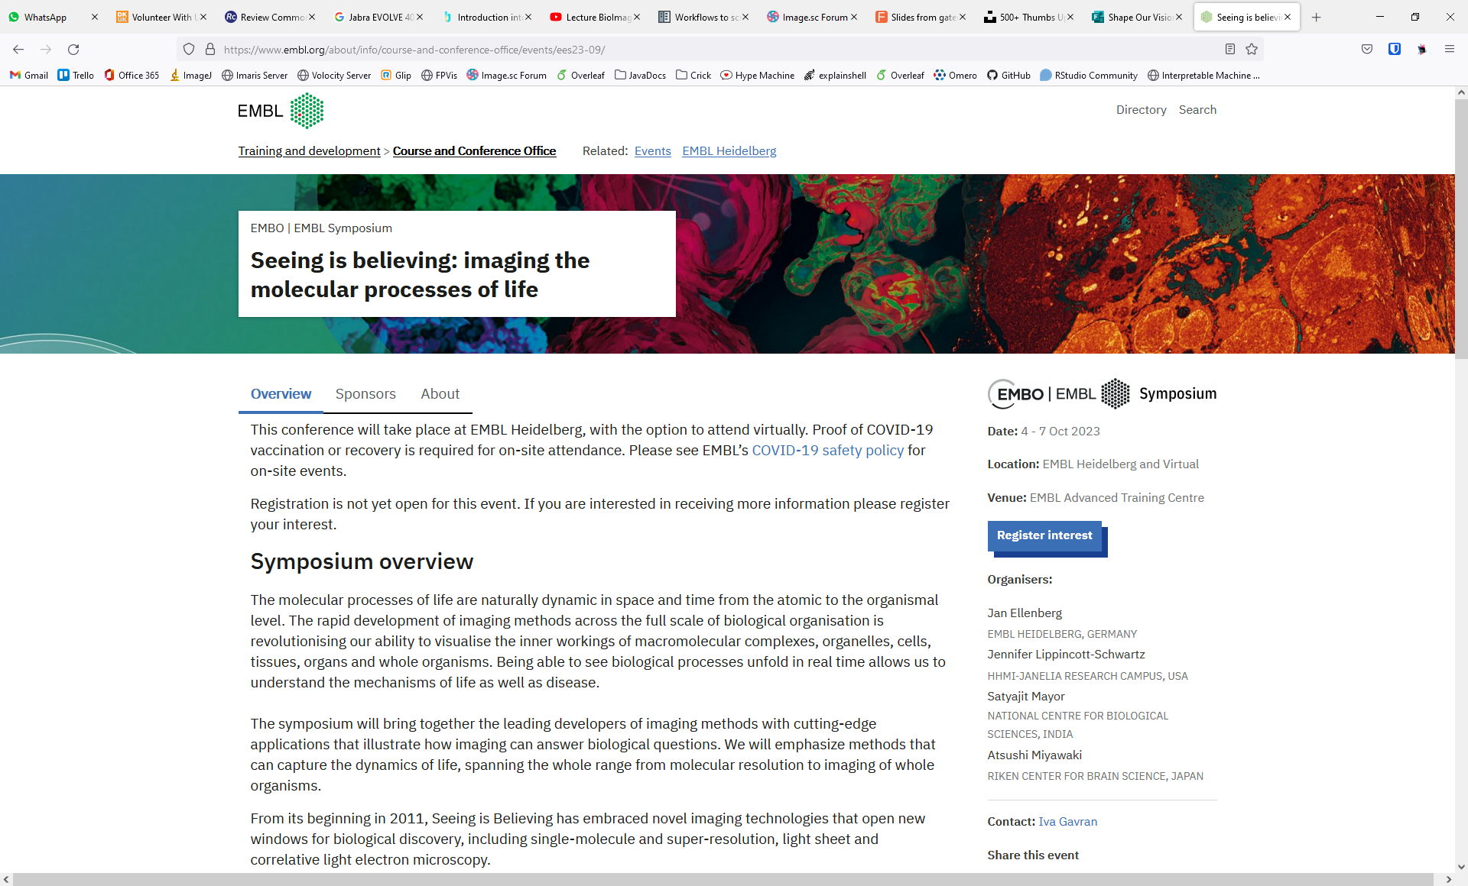

Slide 8
Rule #1: Seeing is believing

Slide 9
Rule #1: Seeing is believing?

Slide 10
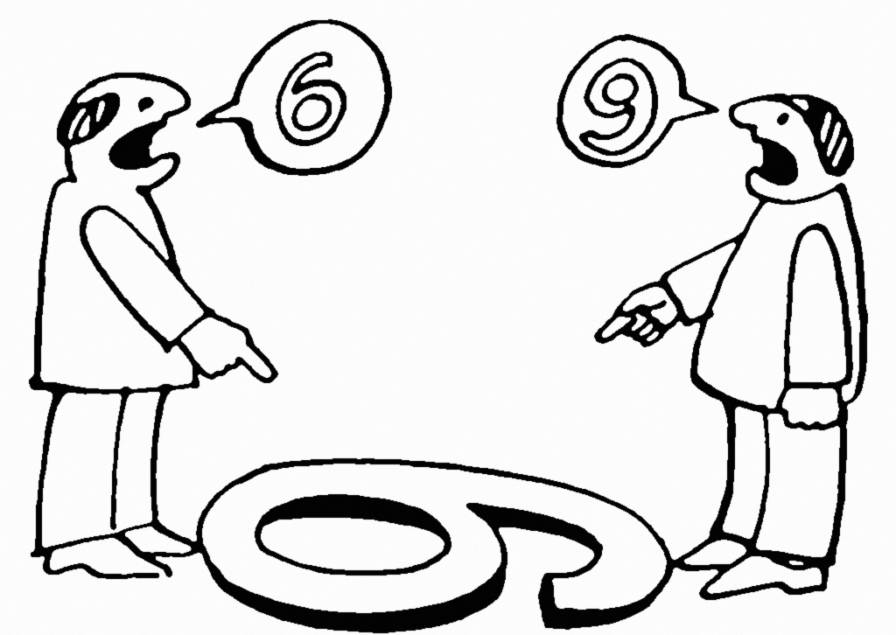
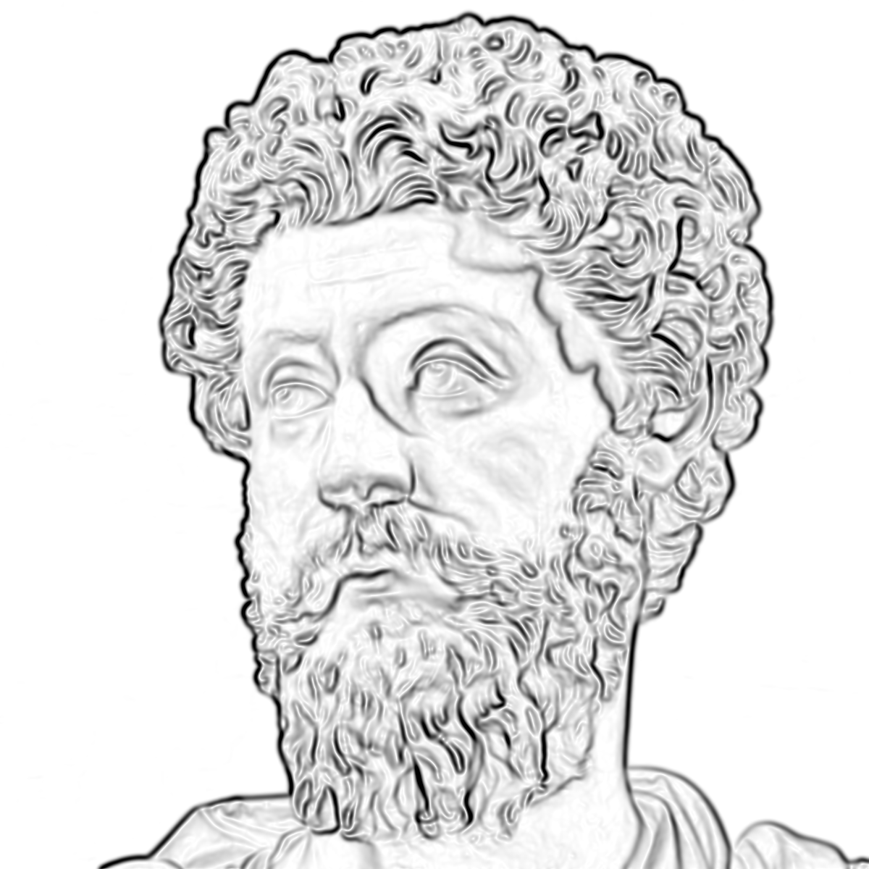
Everything we see is a perspective, not the truth

Slide 11


Slide 12


Slide 13



Slide 14
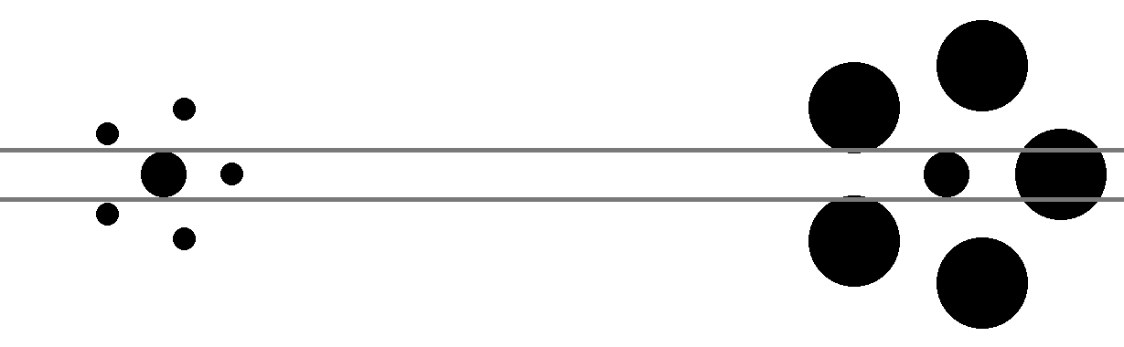


Slide 15
Rule #1: Seeing is believing?

Slide 16
Rule #1: Seeing is not believing

Slide 17
Rule #2: The image is not the result

Slide 18
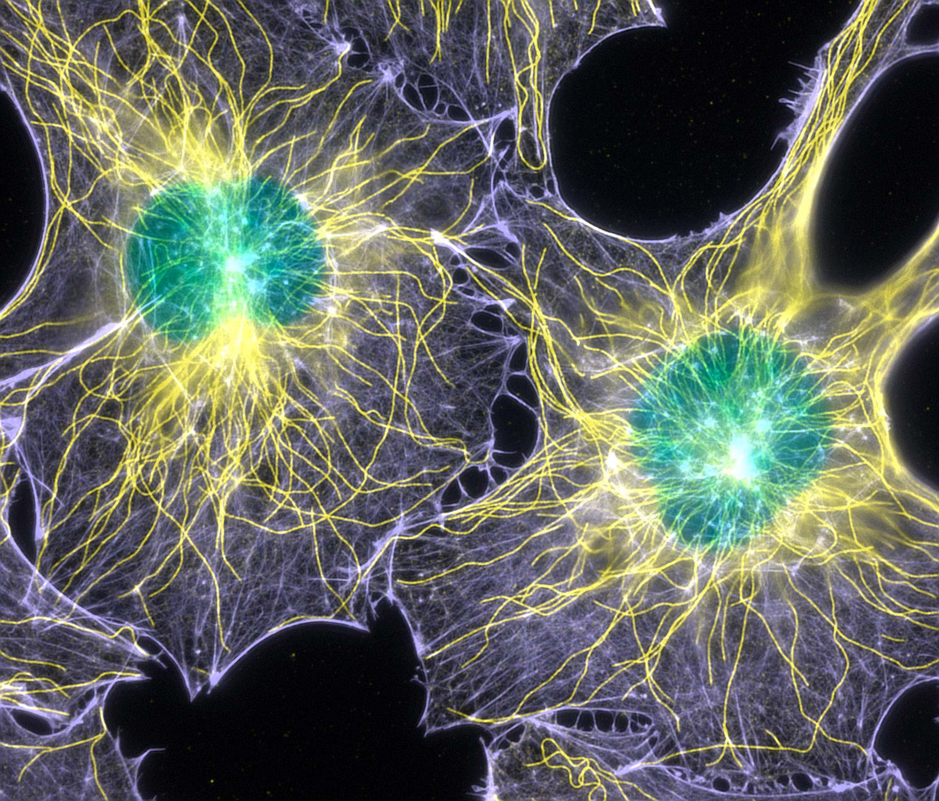
Credit: Torsten Wittmann - Scripps Research Institute
Nikon Small World 2003 Prize Winner

Slide 19
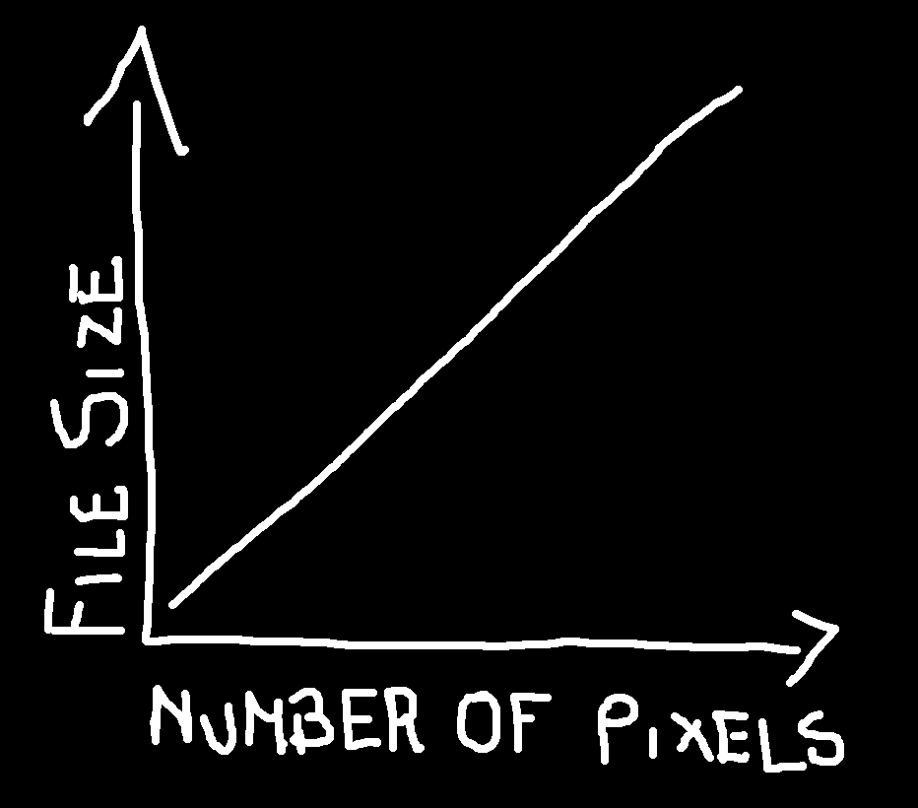

Slide 20
Credit: Torsten Wittmann - Scripps Research Institute
Nikon Small World 2003 Prize Winner

Slide 21
Rule #3: Analysing “by eye” is a really bad idea

Slide 22


Slide 23
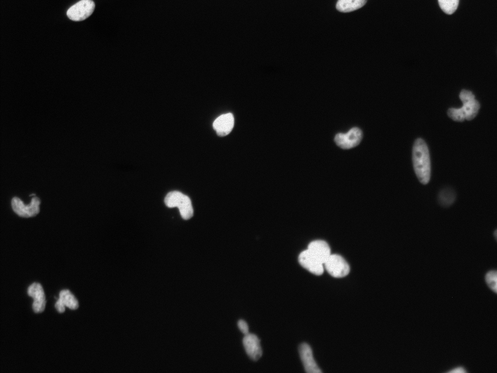
First Quiz: How many nuclei are there?
Notes:
5 minutes, 0 points

Slide 24
First Quiz: How many nuclei are there?
Notes:
5 minutes, 0 points

Slide 25
First Quiz: How many nuclei are there?
Notes:
5 minutes, 0 points

Slide 26
First Quiz: How many nuclei are there?
Notes:
5 minutes, 0 points

Slide 27
First Quiz: How many nuclei are there?
Notes:
5 minutes, 0 points

Slide 28
First Quiz: How many nuclei are there?
Notes:
5 minutes, 0 points

Slide 29
First Quiz: How many nuclei are there?
Notes:
5 minutes, 0 points

Slide 30
First Quiz: How many nuclei are there?
Only count round objects
Don’t count objects at edge of image
Don’t count objects below a certain intensity level
Don’t count clumps of objects as one
Notes:
5 minutes, 0 points

Slide 31
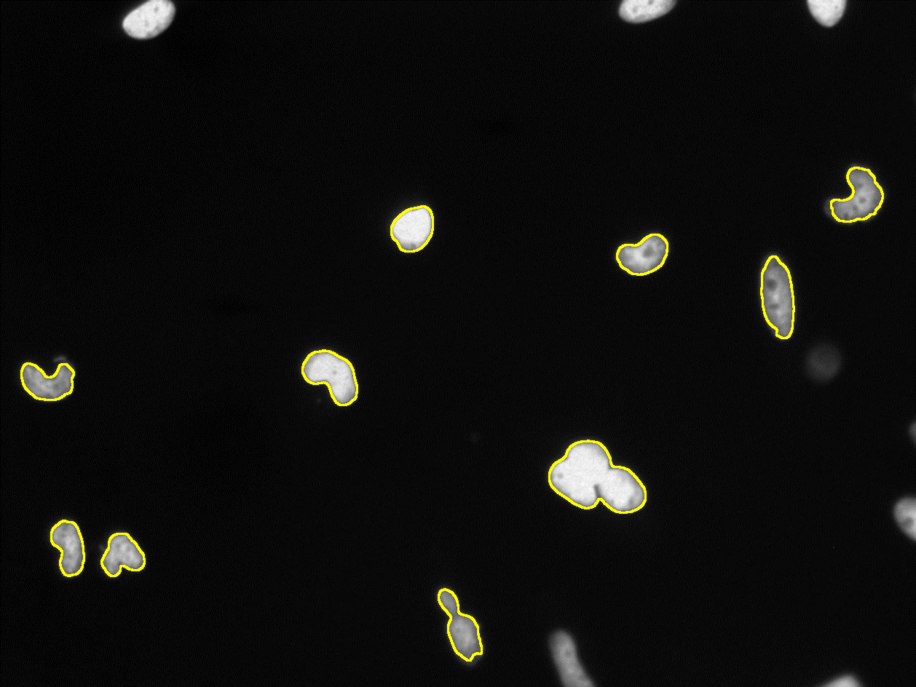
First Quiz: How many nuclei are there?
run("Median...", "radius=2");
setAutoThreshold("IsoData dark no-reset");
run("Convert to Mask");
run("Analyze Particles...", "show=Outlines exclude summarize");
Notes:
5 minutes, 0 points

Slide 32
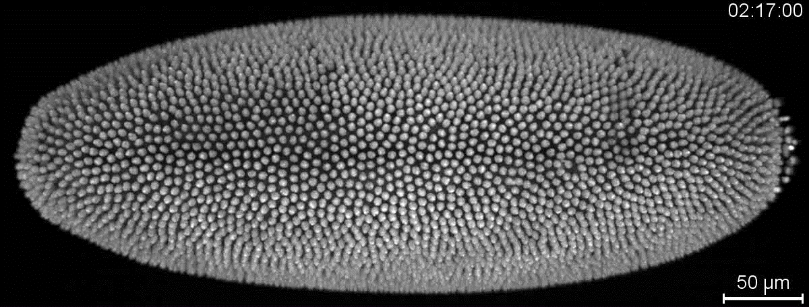
Amat et al., Nat Meth, 2014

Slide 33
Rule #4: Image analysis is hard…

Slide 34
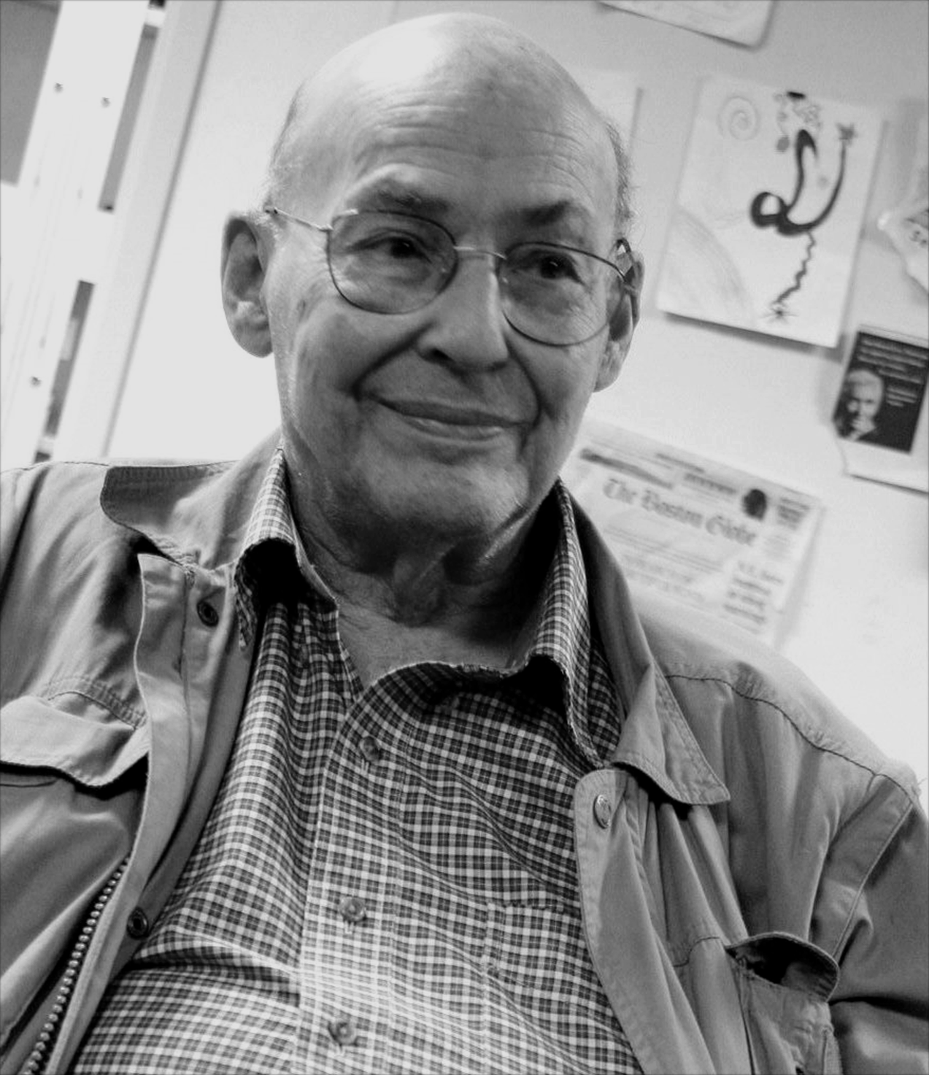
“Connect a camera to a computer and have it describe what it sees”
Marvin Minsky, 1966

Slide 35
Rule #5: Manage your expectations

Slide 36
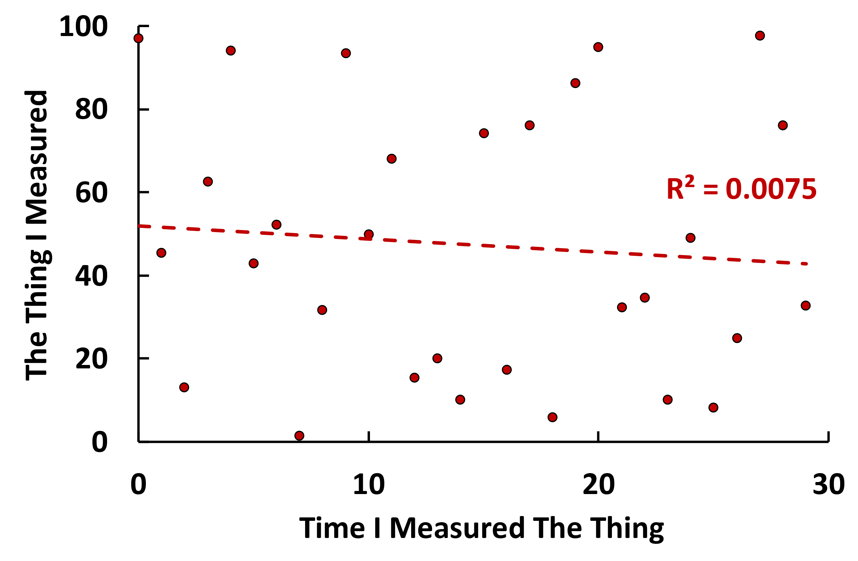
Design Experiment
Prepare Samples
Acquire Images
Analyse Images

Slide 37

Design Experiment
Prepare Samples
Acquire Images
Analyse Images
DESPAIR

Slide 38
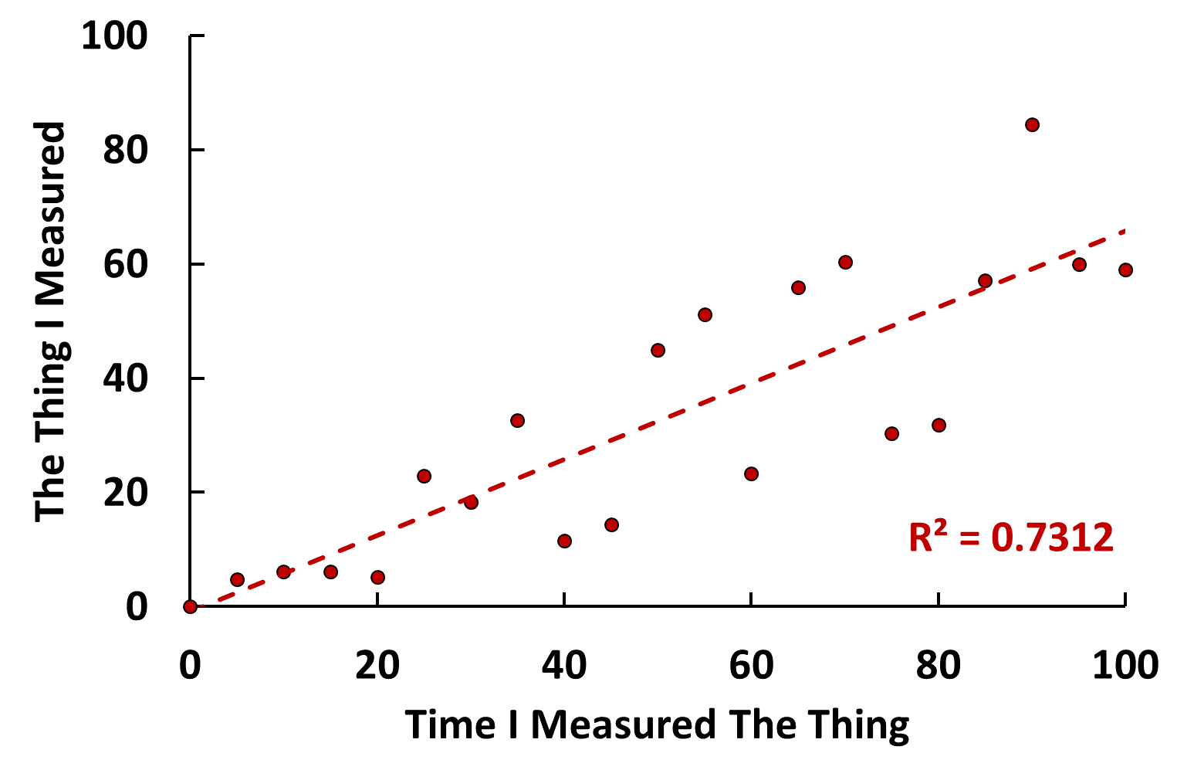

Design Experiment
Prepare Samples
Acquire Images
Analyse Images
GLIMMER OF HOPE

Slide 39

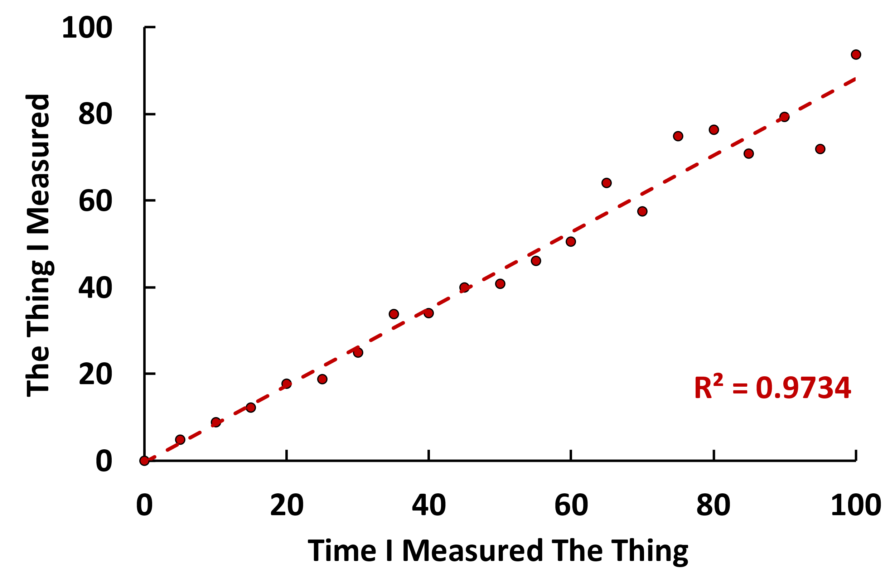

Slide 40
Design Experiment
Prepare Samples
Acquire Images
Analyse Images
Rule #5:
Manage your expectations
Don’t make assumptions!
Do a pilot experiment!

Slide 41
Rule #6: Perfect is the enemy of good

Slide 42
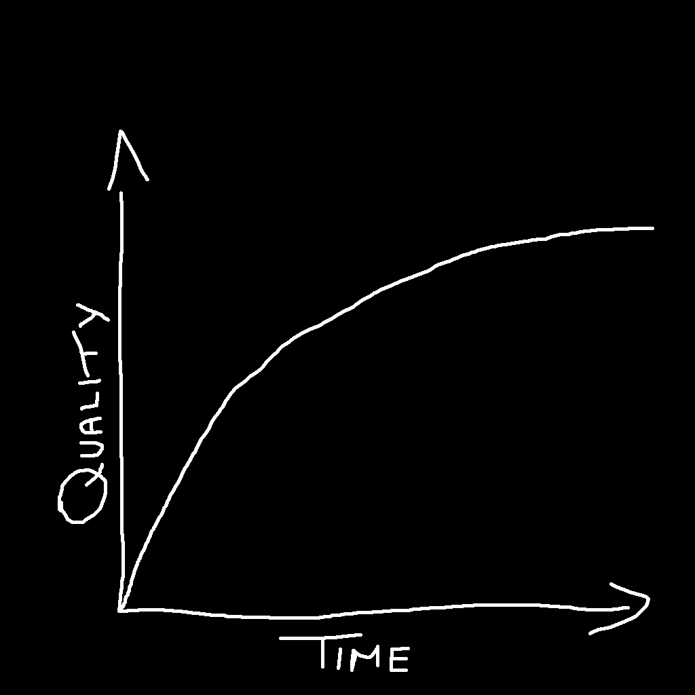
When do I know when my image analysis is good enough?

Slide 43


Everyone makes mistakes

Slide 44
Pipeline with errors
Pipeline with fewer errors

Slide 45
Rule #7: Rubbish In = Rubbish Out

Slide 46
Super Cool, State-of-the-Art, Cutting Edge Image Analysis Pipeline
Sub-Optimal Images
Sub-Optimal Data

Slide 47
Good Images
Not-so-good Images

Slide 48


Sub-Optimal Images

Slide 49
Compulsory Slides on Machine Learning

Slide 50
Rule #8: AI is but one of many tools

Slide 51
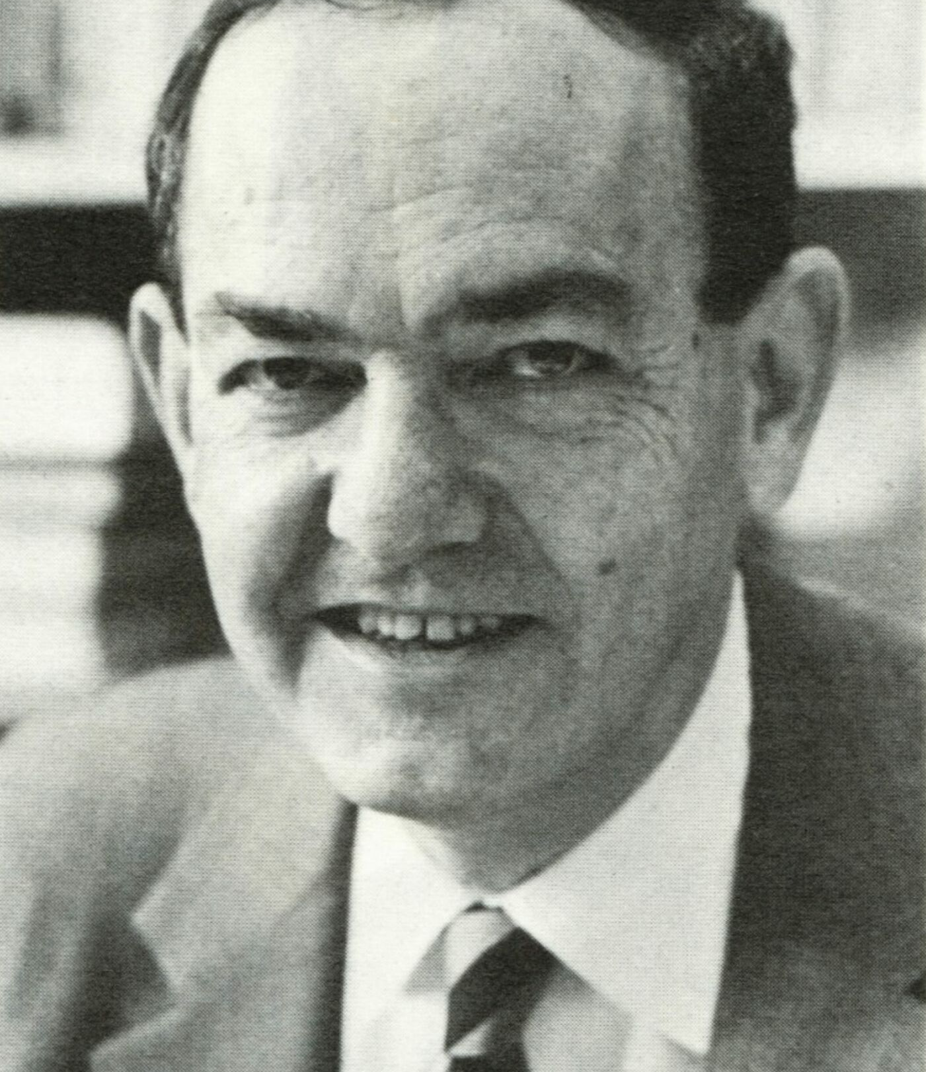
“machines will be capable, within twenty years, of doing any work a man can do”
Herbert Simon, 1965

Slide 52
“Conventional” Pipeline
AI Pipeline

Slide 53
Rule #9: Use the right tool for the right job

Slide 54
FIJI
QuPath
ilastik
CellProfiler
Jupyter
napari

Slide 55
Rule #10: Ask For Help!

Slide 56
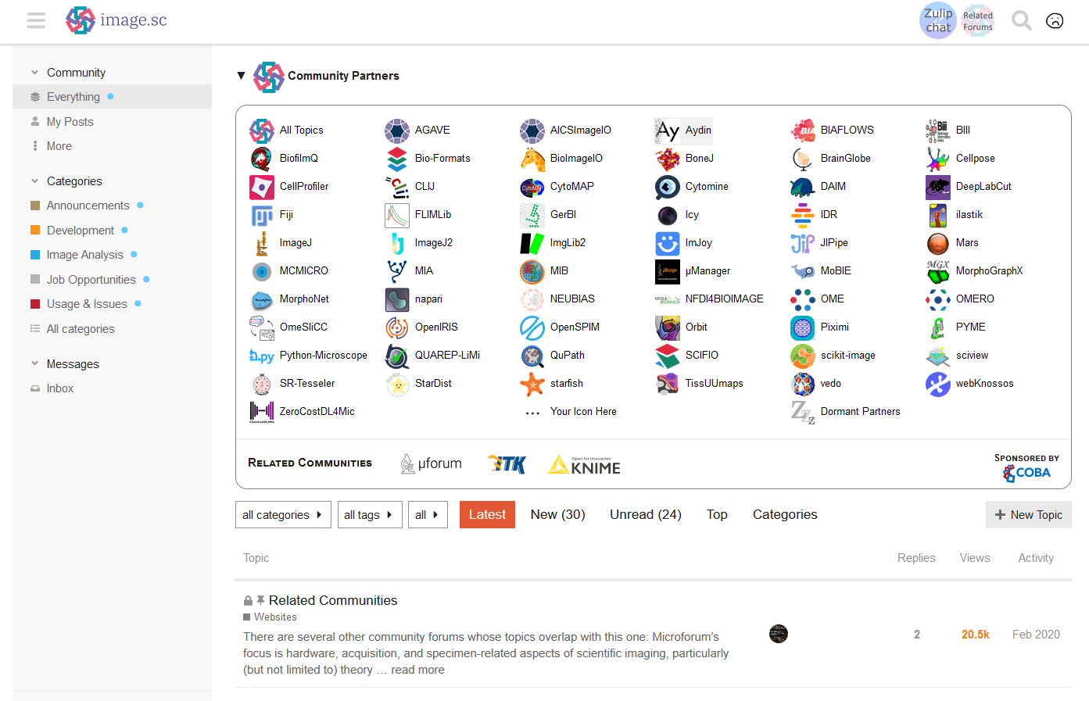
forum.image.sc

Slide 57
Thanks for Listening!
Data
Analysis
In
Microscopy
david.barry@crick.ac.uk
Introduction to automated object counting with…
Dale
Central 3 & 4
Stefania
Stay here!
Martin
Central 5, 6 & 7

Slide 58
Data
Analysis
In
Microscopy
Introduction to automated object counting with…
Dale
Central 3 & 4
Stefania
Stay here!
Martin
Central 5, 6 & 7

